Slide 1
Data Mining - Week 3
Nga Than, Hunter College, Feb 10, 2020

Slide 2
Announcements
DataCamp is ready:
https://www.datacamp.com/home
Problem set 2 will be due on Data Camp in 2 weeks (Feb 17)

Slide 3
Fellowship Opportunities
5 graduate student fellowships at the NYCT: application deadline is 2/18/20 https://www.nycommunitytrust.org/jobs-fellowships/

Slide 4


Slide 5
Patreon Case Study
Does the illegal nature of the data collection and the release of private data taint the data in the release that was already publicly available?
Users of Patreon initially had an expectation of privacy, but that privacy no longer exists. Do researchers need to respect the intent or the reality?
Scholars and journalists share some functions in dealing with information and making it accessible to the public, but are the ethical considerations the same? If not, why not?
Researchers will nearly always claim that their research will have a net public benefit and thus their methods are justified. Who gets to decide is that is accurate in any given case?

Slide 6
Research Projects

Slide 7
Introduction to R
What is R? What is RSTudio?
The term “R” is used to refer to both the programming language and the software that interprets the scripts written using it.
RStudio is currently a very popular way to not only write your R scripts but also to interact with the R software. To function correctly, RStudio needs R and therefore both need to be installed on your computer.

Slide 8
Why R?
R does not involve lots of pointing and clicking, and that’s a good thing
R code is great for reproducibility
R is interdisciplinary and extensible
R works on data of all shapes and sizes
R produces high-quality graphics
R has a large and welcoming community
Not only is R free, but it is also open-source and cross-platform

Slide 9
Little pointing and clicking
The learning curve might be steeper than with other software, but with R, the results of your analysis do not rely on remembering a succession of pointing and clicking, but instead on a series of written commands, and that’s a good thing! So, if you want to redo your analysis because you collected more data, you don’t have to remember which button you clicked in which order to obtain your results; you just have to run your script again.
Working with scripts makes the steps you used in your analysis clear, and the code you write can be inspected by someone else who can give you feedback and spot mistakes.
Working with scripts forces you to have a deeper understanding of what you are doing, and facilitates your learning and comprehension of the methods you use.

Slide 10
Reproducibility
Reproducibility is when someone else (including your future self) can obtain the same results from the same dataset when using the same analysis.
R integrates with other tools to generate manuscripts from your code. If you collect more data, or fix a mistake in your dataset, the figures and the statistical tests in your manuscript are updated automatically.
An increasing number of journals and funding agencies expect analyses to be reproducible, so knowing R will give you an edge with these requirements.

Slide 11
Interdisciplinary
With 10,000+ packages that can be installed to extend its capabilities, R provides a framework that allows you to combine statistical approaches from many scientific disciplines to best suit the analytical framework you need to analyze your data. For instance, R has packages for image analysis, GIS, time series, population genetics, and a lot more.

Slide 12
Diverse types of data
The skills you learn with R scale easily with the size of your dataset. Whether your dataset has hundreds or millions of lines, it won’t make much difference to you.
R is designed for data analysis. It comes with special data structures and data types that make handling of missing data and statistical factors convenient.
R can connect to spreadsheets, databases, and many other data formats, on your computer or on the web.

Slide 13
High Quality Graphics
The plotting functionalities in R are endless, and allow you to adjust any aspect of your graph to convey most effectively the message from your data.

Slide 14
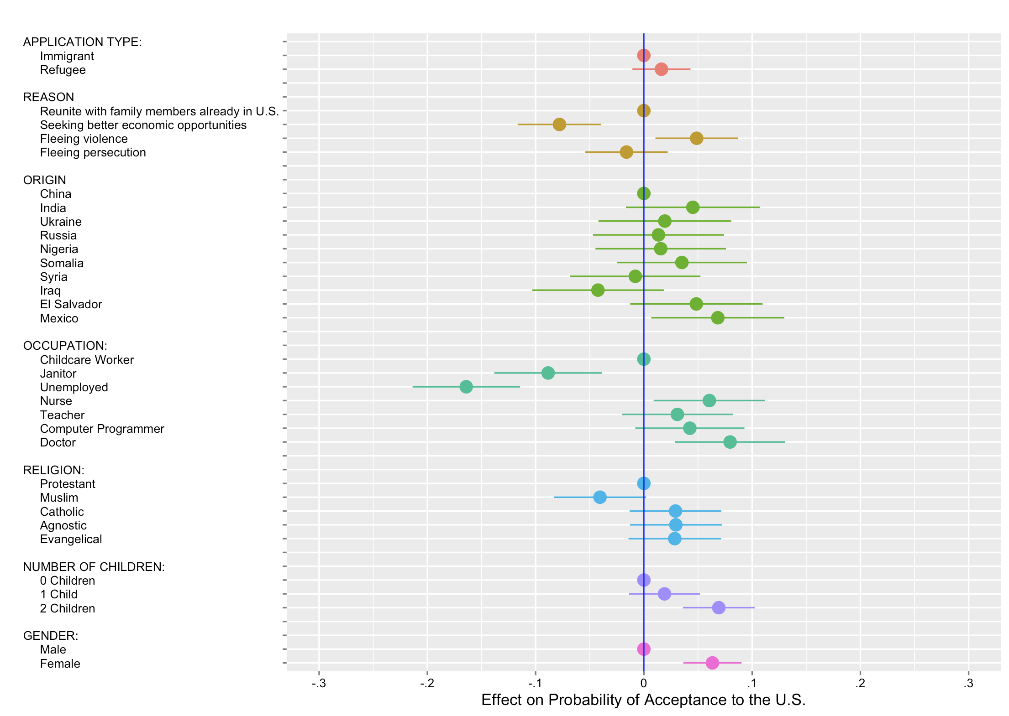

Slide 15
R community is large
Thousands of people use R daily. Many of them are willing to help you through mailing lists and websites such as Stack Overflow, or on the RStudio community.
R-Ladies are very active on Twitter, Slack, and StackOverflow

Slide 16
Free, Open-source Software
Anyone can inspect the source code to see how R works. Because of this transparency, there is less chance for mistakes, and if you (or someone else) find some, you can report and fix bugs.

Slide 17
Part I - R Basics
Familiarize you with R and RStudio functionality,
Help you understand the basics of R programming,
Give you the tools to work with your own data, and

Slide 18
Basics of R
R has over 7,000 user contributed packages at this time. It’s widely used both in academia and industry.
Available on all platforms.
Not just for statistics, but also general purpose programming.
For people who have experience in programming: R is both an object-oriented and a so-called functional language
Large and growing community of peers.
You can use R as it is but combining it with the RStudio interface will help with organization and also provide us with extra options.

Slide 19
Presentation of RStudio
Start RStudio – Let’s start by learning about our tool.
Console, Scripts, Environments, Plots
Code and workflow are more reproducible if we can document everything that we do.
Our end goal is not just to “do stuff” but to do it in a way that anyone can easily and exactly replicate our workflow and results.

Slide 20
Rstudio Layout
Let’s learn where things are and what we can do!
How do you a) open a new R script window?
How do you b) search for the documentation of the function sum?

Slide 21
Rstudio
Bottom left: console window. Here is where R is waiting for you to tell it what to do, and where it will show the results of a command. You can type commands directly after the “>” prompt and R will execute the command. Commands written in this window will be forgotten after you close the RStudio session.
Top left: scripts/editor window. In this R script window, you can write, edit, and save your R commands. Here you can have a complete record of what you did, and you can easily share with others how you did it and you can do it again later on if needed. The RStudio script editor allows you to ‘send’ the current line or the currently selected text to the R console for execution by clicking Run or by using the Command-Enter (for MacOS) or Ctrl-Enter (for PCs) shortcuts. You can also run the full R script.

Slide 22
RStudio
Top right: environment/workspace/history window. Here you can see what data and values R has in its memory. You can view and edit these values by clicking on them. In the history tab, it shows you what you have typed before.
Bottom right: files/plots/packages/help window. The files tab shows you your current working directory’s file and folder structure. The is usually where your project file is saved. The plots tab will show you resulting graphs/figures that you execute. The packages tab will list all the packages that are installed. If the package is loaded, a check-mark will appear next to it. The help tab will show you the documentation for the R functions, datasets, and packages which is helpful for when you come across code that you aren’t sure about.

Slide 23
Rproject/ Working Directory
Under the File menu, click on New project, choose New directory, then New/Empty project
Enter a name for this new folder, and choose a convenient location for it. This will be your working directory for the rest of the day (e.g., ~/intro-r)
Confirm that the folder named in the Create project as a sub-directory of box is where you want the working directory created. Use the Browse button to navigate folders if changes are needed.
Click on “Create project”
In your console (window on the bottom left), first make sure that you’re in your ~/intro-r directory. If not, navigate there. Then, create a folder named data within your newly created working directory. (e.g., ~/intro-r/data)
Create a new R script (File > New File > R script) and save it in your working directory (e.g. intro-r-script.R)

Slide 24
Interacting with R
There are two main ways of interacting with R: using the console or by using script files (plain text files that contain your code).
If R is ready to accept commands, the R console shows a > prompt. If it receives a command, R will try to execute it, and when ready, show the results and come back with a new > prompt to wait for new commands.
If R is still waiting for you to enter more data because it isn’t complete yet, the console will show a + prompt. It means that you haven’t finished entering a complete command. This is because you have not ‘closed’ a parenthesis or quotation. If you’re in Rstudio and this happens, click inside the console window and press Esc or Ctrl-C; this should help you out of trouble.

Slide 25
Using Script Files
One of the highlights of RStudio is the text editor. It contains a lot of handy features that make coding easier. For now, we’ll just use some basic features.
Let’s open a new R script. In the top left corner of your RStudio window, there should be a paper icon with a green plus sign over it. Click on it and select “R Script” from the dropdown menu. A new blank script should appear in your top left pane. This is essentially a text file, but since it has a “.R” extension, you can use it to “talk” to your R console. What I mean is that instead of typing commands directly into the console or copying and pasting, you can run code directly from the script.

Slide 26
Script File
A nice feature of R is that it is interactive. You can run a single line of code at time without needing to run the entire script.
Lets do some math in your script. Type 3 + 3 into your R script. Place your cursor at the end of the line and press Cmd-Enter (Ctrl-Enter if you have a Windows). You should now see the output in your R console! If you want to run more than one line of code, you can highlight the code you want to run and press Cmd-Enter.
Now, let’s save our script with File -> Save or File -> Save As. R should default to your working directory. Save it wherever the .RProj file is located.

Slide 27
Script File
Now, quit your RStudio session. You may be confronted with a message that asks “Save Workspace Image?” ALWAYS SAY NO. It will create headaches if you save it. It takes forever if you have a lot of stuff in your environment and writes all of your objects to disk. While saving everything you’re working with may sound like a good idea, but you’re now responsible for remembering what each file is for. Also, what R saves may not actually reflect what was in your environment. Just suffice it to say that saving your workspace image is a bad idea.

Slide 28
Rproject
We’re gonna learn how to open your R project again. There are two avenues:
Double click your .RProj file. This will open your R project in a new window and everything will be there ready to go.
Open RStudio. RStudio may automatically open your most recent project. In that case, you don’t have to do anything. Otherwise, go to File -> Open Project and navigate to your .RProj file. Open this and you’ll be good to go!
Note: Don’t just double click the .R file or open the .R file in RStudio without opening your .RProj first. If you don’t open your R Project, things may break.

Slide 29
Objects and Functions
Creating objects
You can get output from R simply by typing math in the console:H
However, you often need to save output or values to objects. Storing values in objects allows you to do interesting things with them later. To create an object, you pick a succinct, easy to remember name and then use the assignment operator <- to give the name a value. The format is name <- value. The value on the right is assigned to the object on the left.
For instance: head_size <- 40

Slide 30
Objects
This statement can be interpreted as “40 goes into head_size”. For historical reasons, you can also use = for assignments, but not in every context. Because = can throw unexpected results in some situations, it is good practice to always use <- for assignments.

Slide 31
Object
Objects can be given any name such as x, body_size, or signal_length. You want your object names to be explicit and not too long. They cannot start with a number (2x is not valid, but x2 is). R is case sensitive (e.g., weight_kg is different from Weight_kg). There are some names that cannot be used because they are the names of fundamental functions in R (e.g., if, else, for, see here for a complete list). In general, even if it’s allowed, it’s best to not use other function names (e.g., c, T, mean, data, df, weights). If in doubt, check the help to see if the name is already in use. It’s also best to avoid dots (.) within an object name as in my.data. There are many functions in R with dots in their names for historical reasons, but because dots have a special meaning in R (for methods) and other programming languages, it’s best to avoid them. It is also recommended to use nouns for object names, and verbs for function names. It’s important to be consistent in the styling of your code (where you put spaces, how you name objects, etc.). Using a consistent coding style makes your code clearer to read for your future self and your collaborators. In R, three popular style guides are Google’s, Jean Fan’s and the tidyverse’s. The tidyverse’s is very comprehensive and may seem overwhelming at first. You can install the lintr package to automatically check for issues in the styling of your code.

Slide 32
Exercise 1
Which of the following object names is invalid?
site_num
R2
1st_try
fish.scale.size

Slide 33
Objects
You might have noticed that assigning a value to an object doesn’t print anything. To print the value, you can either use parentheses around the assignment or type the object name:
head_size <- 40 # doesn't print anything
(head_size <- 40) # prints output

Slide 34
###Comments
Important aside: The comments written to the right of the hash mark don’t get run as code. Using informative comments is good coding practice. Clear comments are essential for when you want someone else to run your code and be able to interpret what you’re typing. In addition, they’re critical for you to understand what you did when you have to read your code two months (years, decades) later. Clear comments should state what you are doing, define your objects, and clarify any non-standard code you may employ. Don’t assume that you’ll know what your code means down the line!

Slide 35
Objects
Okay, now that head_size is in memory, you can do things with it! Let’s try some math.
# take the square of head_size
head_size ** 2
what is the value of head size now? Why do you think that is?

Slide 36
Modifying Objects
If you want to change an object’s value, just assign it a new one. Your object’s value doesn’t change until a new assignment is made. R will not hesitate to overwrite the value, giving you no warnings when you are doing so. So, be careful and always double-check that the object doesn’t already exist or you are sure in your intent to overwrite!
# assign a new number
(head_size <- 45)
# assign a new value with arithmetic
(head_size <- head_size * 1.25)

Slide 37
Exercise 2
Create a new object called weight_kg and assign it the value 70. Now, divide it by two and convert it to pounds, using the conversion factor 2.2. Assign this new value to the object weight_lb.

Slide 38
Functions
When you want to make something happen in R, you can call a function. Most functions will produce results that you can see immediately, such as the sqrt() (square root) function in R. sqrt() is part of the base R package that comes with your installation of R.
sqrt(16)
You can think of functions as “canned scripts” that automate more complicated sets of commands. The structure of “calling” (or “running” or “executing”) a function is: function(argument1, argument2, ...). Calling the function results in some sort of output. Functions can take one or a few inputs, or arguments (see below). The sqrt() function has one argument, which we supply the value 16 to. It outputs, or returns, a single numeric value.

Slide 39
Arguments
The input you provide for your function are called arguments. Some functions take a single argument while others take multiple.
#Example of a function that takes a single argument:
factorial(3)
## [1] 6
#Example of a function that takes multiple arguments:
paste("Hello", " World!", sep = "")
## [1] "Hello World!"

Slide 40
arg()
args()
The args() function tells you what inputs, or arguments a function recognizes.
#For example:
args(round)
## function (x, digits = 0)
## NULL

Slide 41
Arg()
From the output of args(round), we know that this function takes 2 arguments, x and digits. Looking at the help documentation (you’ll learn how to access that in a second), the x argument requires a number or a set of numbers that you wish to round. The digits argument requires a whole number that determines the number of decimal places you want to round to. The = 0 part of digits = 0 denotes a default value. In this instance, the round() function will round to the first whole number if you don’t supply the digits argument with a value.

Slide 42
Exercise 3
See what arguments are within the sum() function.

Slide 43
Marching Arguments
You can also use the names of the arguments to specify the input. If you don’t use argument names, R will match your inputs based on the order that they are written.
log(100, 10)
## [1] 2
#is different from
log(10, 100)
## [1] 0.5

Slide 44
Argument
Specifying your input with the argument names can help avoid potential errors.
# both of these return the same value
log(x = 100, base = 10)
## [1] 2
log(base = 10, x = 100)
## [1] 2

Slide 45
Default Arguments
Some arguments are optional, such as base in log(). In the case of an optional argument, you need not supply a value and the function will still run. In this case, the base argument has a default value of exp(1) and if you do not provide an alternative base value it will use its default value. However, the argument of x is not optional and requires an input or the function will not run.

Slide 46
Code Body
Typing the name of the function without the parentheses will return the code that is stored in the function. A couple examples of where this can be helpful are if you are performing a statistical test and you want to know exactly how R is performing the calculations, or you are looking for inspiration for writing your own functions. Here is an example with the cor() function, which calculates correlations among variables. I restricted the output to only the first ten lines here- there is a lot of underlying code to calculate a correlation!

Slide 47
Cor()
## function (x, y = NULL, use = "everything", method = c("pearson",
## "kendall", "spearman"))
## {
## na.method <- pmatch(use, c("all.obs", "complete.obs", "pairwise.complete.obs",
## "everything", "na.or.complete"))
## if (is.na(na.method))
## stop("invalid 'use' argument")
## method <- match.arg(method)
## if (is.data.frame(y))
## y <- as.matrix(y)

Slide 48
Getting Help
I don’t think I have ever had a coding session where I didn’t have to get help at least once. Effectively getting help for a problem in R is a crucial skill. Programmers often joke that they don’t actually code, they’re just really good at using Google. While a bit of an exaggeration, this isn’t far off from the truth. However, before jumping straight to Google, there are a few places within R and RStudio where you can get help.
Adding a ? in front of a function will open up the documentation for that particular function. If you’re using RStudio, it’ll open in your help tab. It can help explain what that function can do and serves as a pretty useful help page when you are learning or troubleshooting.
# you don't need the parentheses, but ?sum() also works
?sum

Slide 49
Help
A typical help page has these sections: Description, Usage, Arguments, Details, Value, S* methods, References, See Also, and Examples.

Slide 50
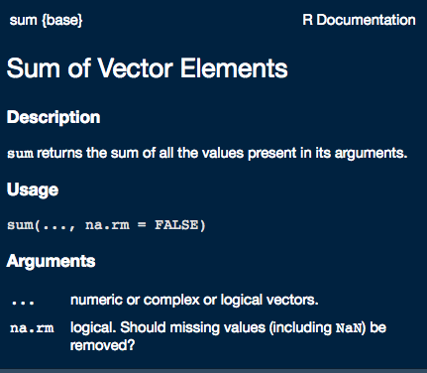

Slide 51
Explore
Explore the sum() help page to get an idea of what a help page looks like. Feel free to look around at the help pages for different functions when you’re comfortable with the sum() page.
Sometimes you may not know the exact name of the function you need help with or you only know the package it came in (we’ll get to what a package is later. For now, think of it as a folder that holds a suite of functions). In this case, ?? is helpful. ?? executes a broader search of R, looking for functions and packages that contain your search terms. It will return Vignettes, Code demonstrations, and Help pages that contain your search term.
Try this in your console:
??mean

Slide 52
Help
Depending on the function author, the help pages can either be very informative and clear, or they can be opaque. They may have plenty of information about one use of the function, but nothing about the use you’re interested in. Maybe you’re trying to run your function and a weird error message keeps popping up. Maybe you want to perform an analysis, but don’t know which function(s) are appropriate. In this case, Google is your friend. In most cases, especially for beginners, your question has already been answered somewhere. The hard part is entering the correct search terms and knowing where quality answers are.
I’ll demonstrate a typical Google search here. You’re interested in rounding a bunch of numbers to the nearest tens place (e.g. 46 rounds to 50), but the round() function appears to only round to digit values. You scanned the help page, but didn’t notice anything that solves your problem. So, using your R googling skills, you search “round to the tens place r”. R is sufficiently common that tacking on “r” or “r stats” to the end of the question is enough to find an R solution for your problem.

Slide 53
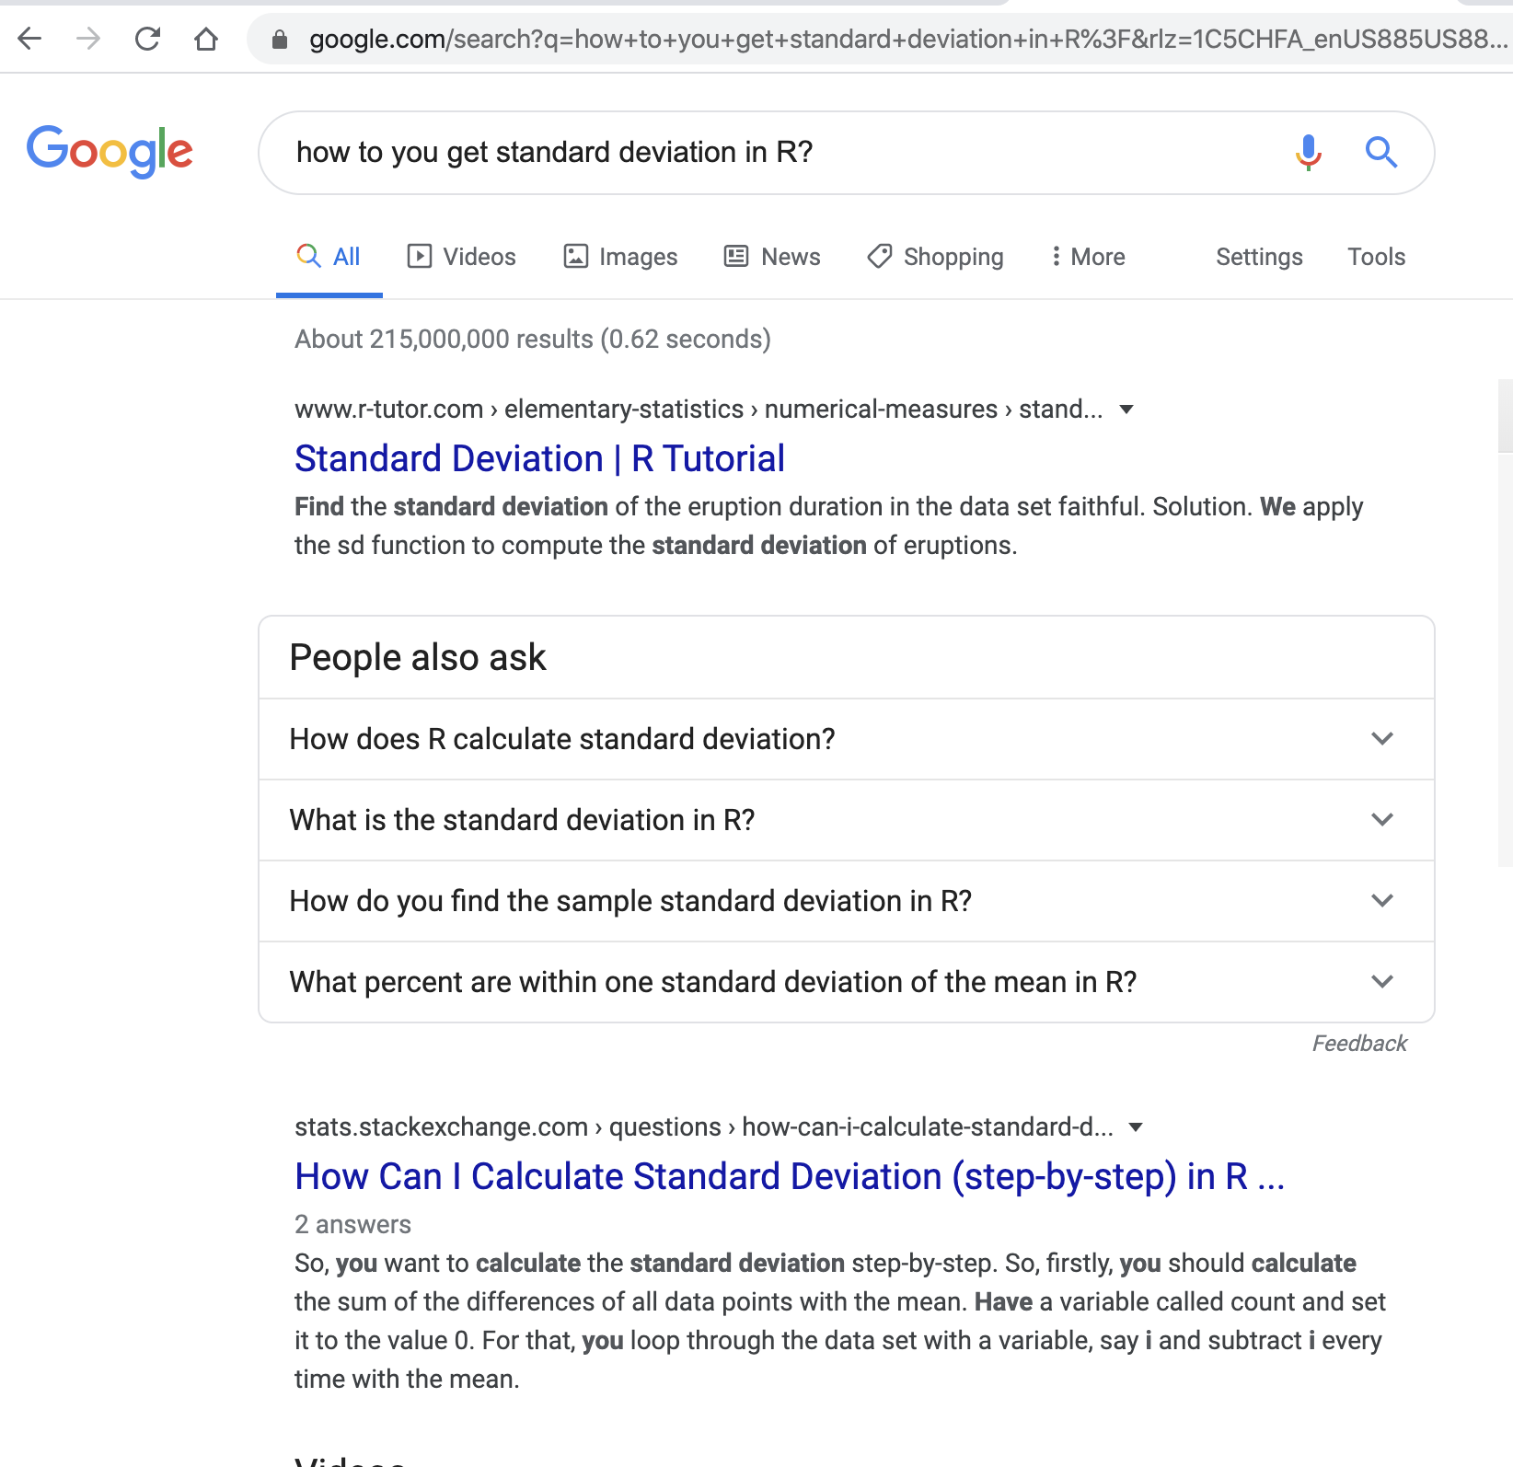

Slide 54
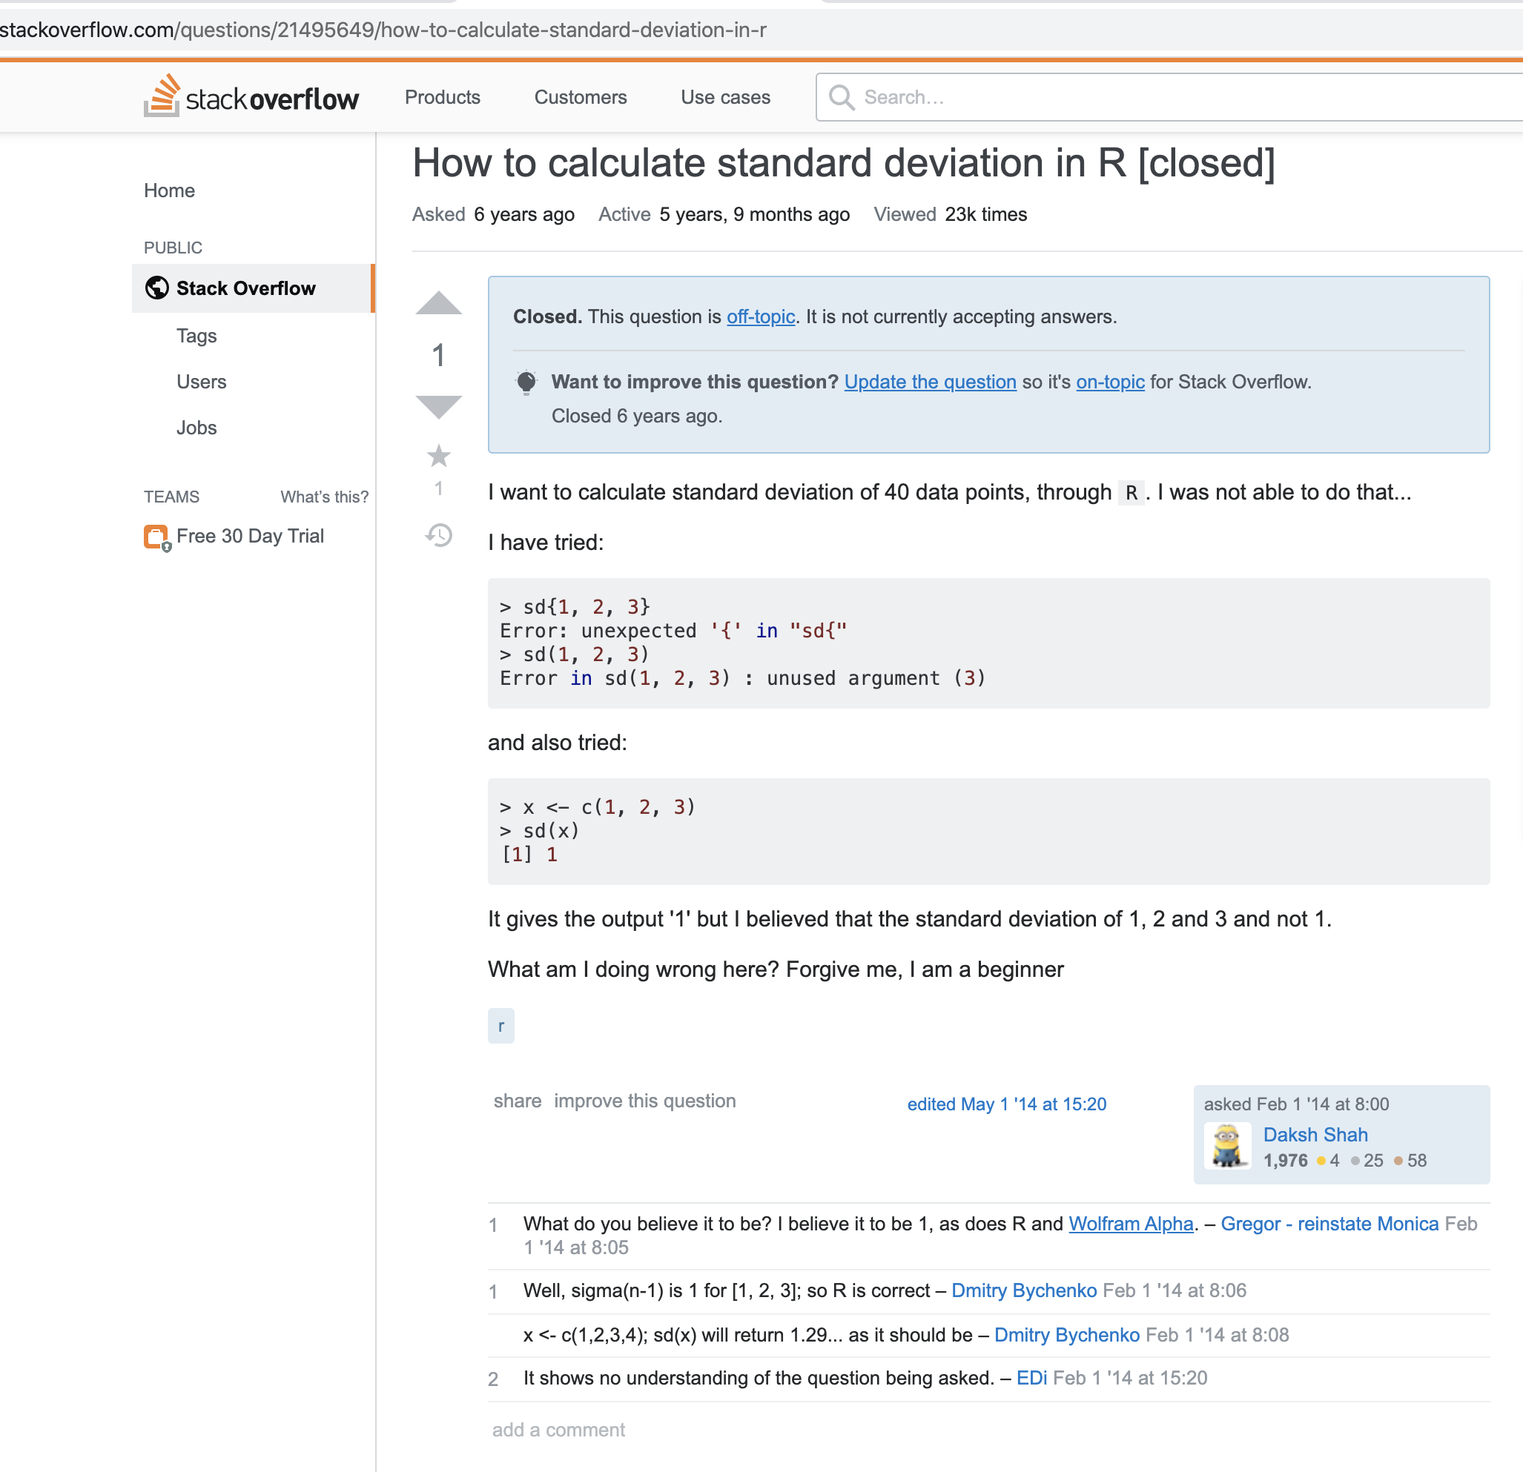

Slide 55
Break - 10 mins

Slide 56
Vectors and Data Types
What is a vector?
A vector is the most basic data structure in R and is foundational to coding in R. A vector is a series of values that all have the same data type. We will elaborate on data types later, but numbers and characters are two examples.
my_vector <- c(1, 2, 3, 4)
#print the vector my_vector

Slide 57
Vectors
c() function
b <- c(1, 2, 3, 4)
# You can add one to each element of the vector
b + 1
You can also name the elements in your vector to increase their accessibility.
c <- c(pop = 10, soda = 20, cola = 30)

Slide 58
Data Types
R interprets the type of your vector based on the characteristics of its values.
Each data type has its own unique properties.
Here is a list of the different data types:
int stands for integers, or whole numbers.
dbl stands for doubles, or numbers with decimals.
chr stands for character vectors, or strings.
dttm stands for date-times (a date + a time).
lgl stands for logical, vectors that contain only TRUE or FALSE.
fctr stands for factors, which R uses to represent categorical variables with fixed possible values.
date stands for dates.

Slide 59
Data Types
typeof() is a handy function that returns the data type of your vector. If you’re ever in doubt, check your vector with typeof()!
dec <- c(3.24, 5.4, 2.04, 6.55)
typeof(dec)
## [1] "double"

Slide 60
Vectors
Some functions require vectors. For example, the mean() function computes the mean of a vector.
my_nums <- c(3, 5, 5)
mean(my_nums)
## [1] 4.333333

Slide 61
Vectors
Subsetting vectors
What do you do if you wanted to extract a specific element or elements in a vector? Square brackets [] with one or more indices inside allow you to do this.
z <- c(10, 11, 12, 13, 14, 15)
z[3]

Slide 62
Functions
Write your own function:
function_name <- function(arg_1, arg_2, arg_3 = 2) {
# do some useful stuff new_var <- sum(arg_1) + sum(arg_2)
# do some more useful stuff div_out <- new_var / arg_3
# return the value return(div_out) }

Slide 63
Example: Average Function
take_avg <- function(x){ # this function takes the same of all values in x. Assumes x is a numeric vector
s <- sum(x) # this counts the number of elements in x
l <- length(x) # we're dividing the sum of values by the number of values to calculate the mean
avg <- s / l # this specifies the value to be returned by the function
return(avg) }

Slide 64
More on Functions
https://r4ds.had.co.nz/functions.html

Slide 65
Recap
Vectors
Data Types
Function

Slide 66
Data Structure
The primary data structures in R are vectors (which we’ve already introduced), lists, and data frames. Data frames are the de facto way to store tabular data, and are effectively a combination of vectors and lists. Therefore, I’ll introduce the concept of a list first, then jump right into data frames!

Slide 67
Lists
Lists are objects where you can store different data types. While vectors only store a single data type, each “slot” in a list can contain something different, and they can be almost arbitrarily complex.
list_data <- list("Bob", "Rachel", c(10, 2, 3), TRUE, FALSE, 22.4)
List_data #print your data
Ex 2: my_list <- list("All", "dogs", "are", "good", "dogs")
What is my_list[[4]]

Slide 68
Data Frames
Data frames are tabular representations of data where the columns are vectors of equal length. Each column must contain a single type of data (remember, they’re vectors!). Typically, you’ll either load in data that is recorded in spreadsheet format (e.g. an Excel sheet), or you’ll coerce non-tabular data into a data frame format (e.g. JSON files, which aren’t natively represented as a table). R is optimized to use data frames for statistical analysis and data visualization, so it’s important you become familiar with them!

Slide 69
Tidy Data
Tidy data is tabular data, where each column is a variable and each row is an observation.

Slide 70
Assignment
Datacamp assignment: Introduction to R course (4 hours of work, 15 videos,and exercises) - Due in 2 weeks (Feb - 17)

Slide 71
Data Camp
https://www.datacamp.com/home
Let me know if you have problem with Data Camp!

Slide 72
Week 3 - Evaluation
https://tinyurl.com/DM2020-W3

